Slide 1
Module 1
Introduction to Linux

Slide 2
History of Linux
Unix: Developed in 1969 by Dennis Ritchie and Ken Thompson. It was initially designed for Power System, Motorola, and HP systems.
Linux: Developed in 1991 by Linus Torvalds. It is an operating system that is Unix-like.
"Linus" → "Linux"
"Unix" → "Linux"
GNU: The term stands for "GNU's Not Unix."
GNU made many tools (compiler, editor, libraries) but not the kernel.

Slide 3
History of Linux
1992–1994 – Linux Becomes Free & Powerful
In 1992
Linux was released under GNU GPL license (Free Software License).
This allowed:
Anyone to use Linux
Anyone to modify Linux
Anyone to share Linux
In 1994:
Linux kernel version 1.0 was released.
It became stable enough to use publicly.

Slide 4
History of Linux
1995– Rise of Linux Distributions
Linux alone is just a kernel.
Different organizations started adding software + tools to make complete OS versions called "Linux distributions".
Popular early distributions:
Slackware
Debian
Red Hat

Slide 5
History of Linux
2000s – Linux Goes Enterprise
Large companies started using Linux because:
It is stable
Secure
Free
Companies like:
Google Amazon
IBM Facebook
All started building their systems using Linux.

Slide 6
Flavor of Unix And Linux
Unix Family: Includes Unix, HP-UX, IBM → (AIX), Mac OS, and Solaris.
Linux (Major Communities):
Red Hat Communities
Debian Communities
Red Hat Communities: Includes Red Hat Enterprise Linux, CentOS and fedora
Debian Communities:Includes Ubuntu, Mint, Kali and OpenSuse.

Slide 7
Flavor of Unix And Linux
Unix Family: Includes Unix, HP-UX, IBM → (AIX), Mac OS, and Solaris.
Linux (Major Communities):
Red Hat Communities
Debian Communities
Red Hat Communities: Includes Red Hat Enterprise Linux, CentOS and fedora
Debian Communities:Includes Ubuntu, Mint, Kali and OpenSuse.

Slide 8
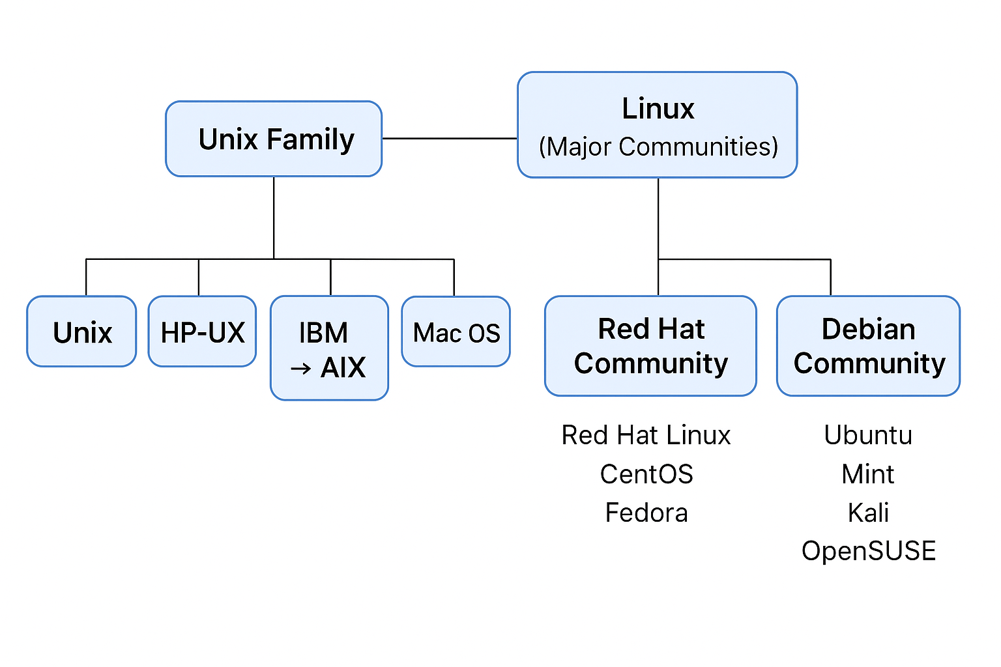
Flavor of Unix And Linux

Slide 9
Linux Kernel
Linux kernel is the core (heart) of the Linux operating system.
It controls how software talks to hardware (CPU, RAM, storage, etc.).
Without the kernel, Linux OS can't work.
Controls running programs (processes).

Slide 10
Linux Kernel
Decides which program uses CPU and when.
Kernel Acts as a Mediator between the Shell and the Hardware
Instruction→Shell→Kernel→Hardware

